Slide 1
Ben Crow
Web Developer (In Training)

Slide 2

My Portfolio Website:
https://becrusty.github.io

Slide 3

Design Process
Google/ Pinterest
Mood Board & Drawn Wire-Frames
Low-Fi Wireframe
Iterate

Slide 4

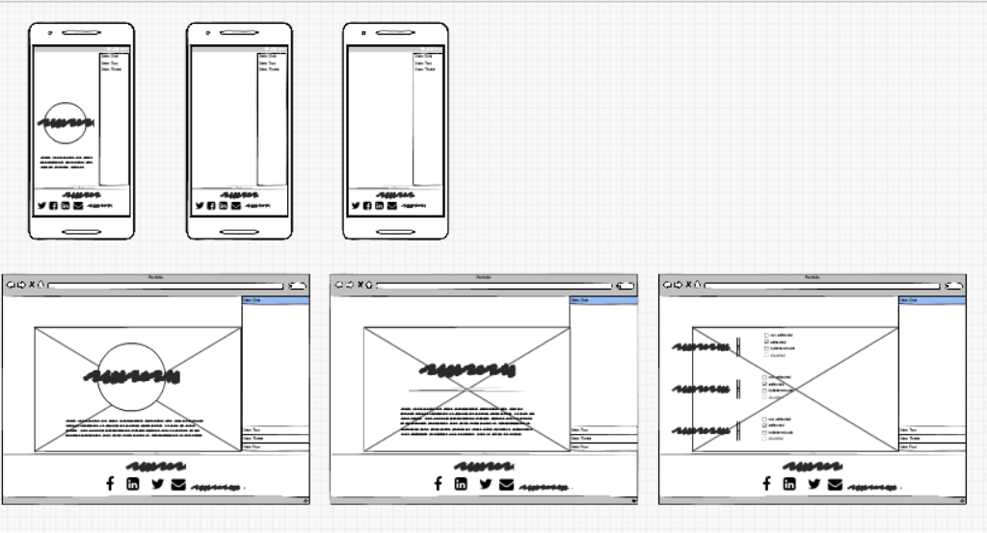
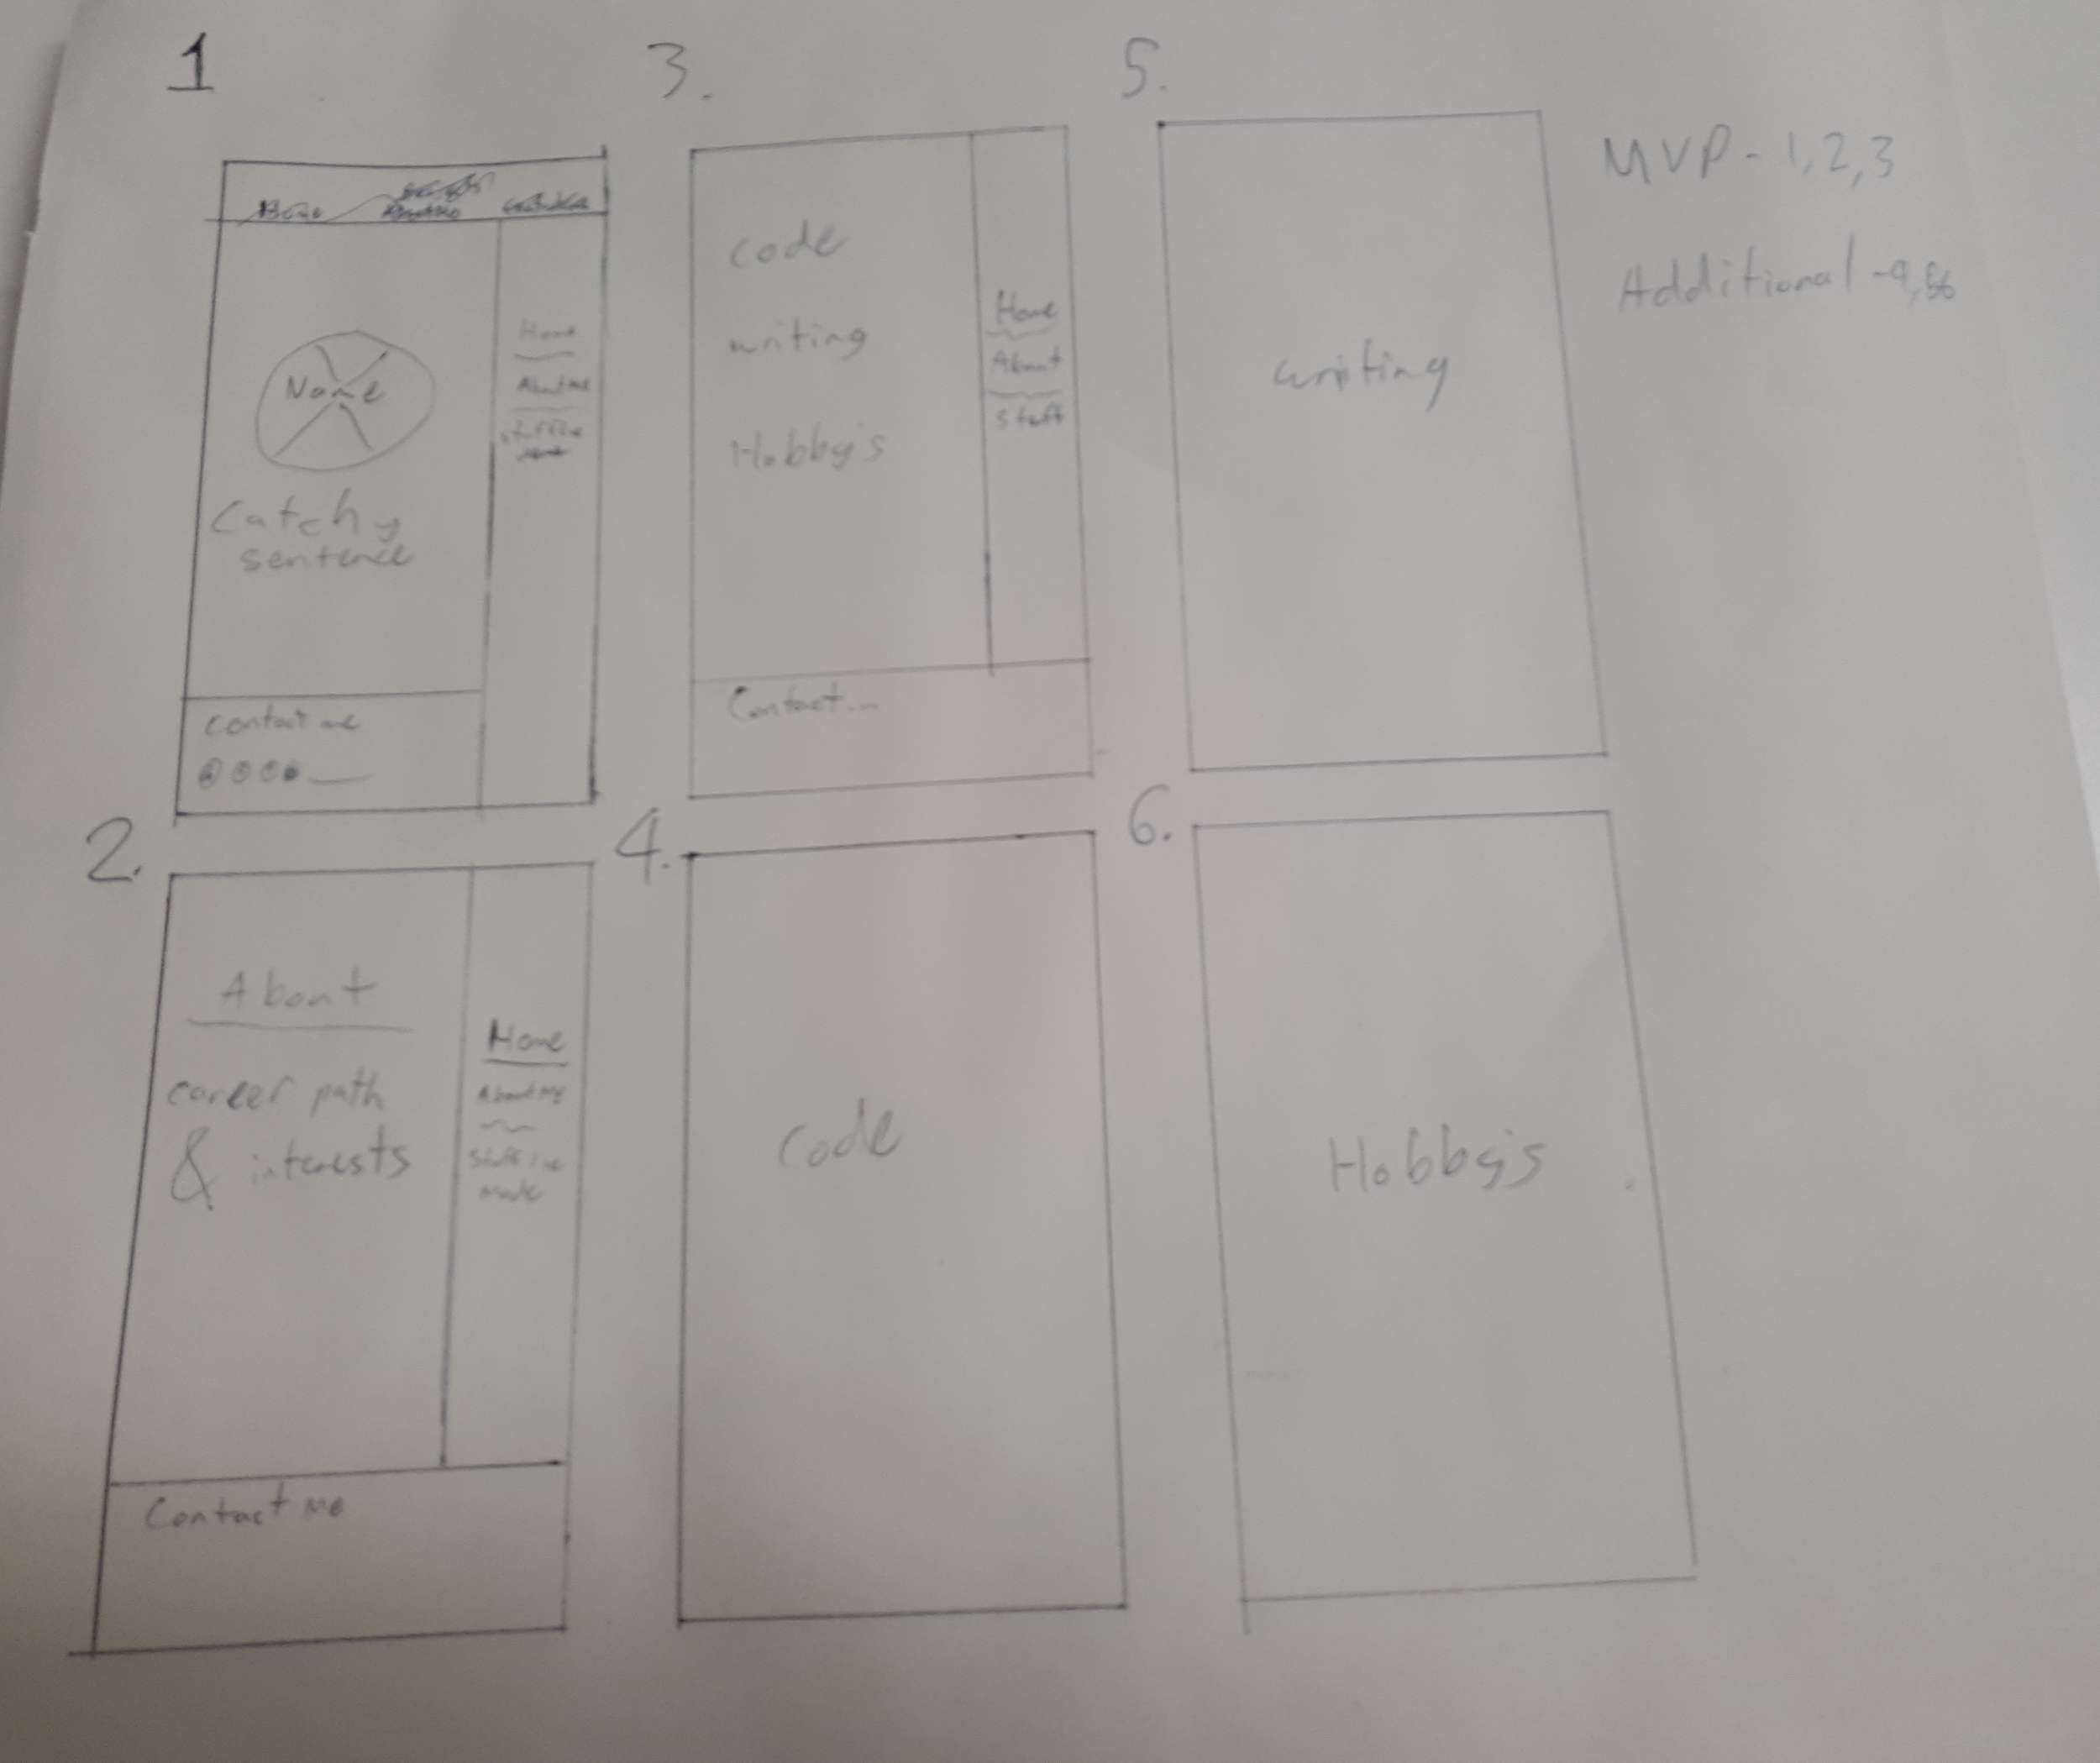
Decision Time!

Slide 5

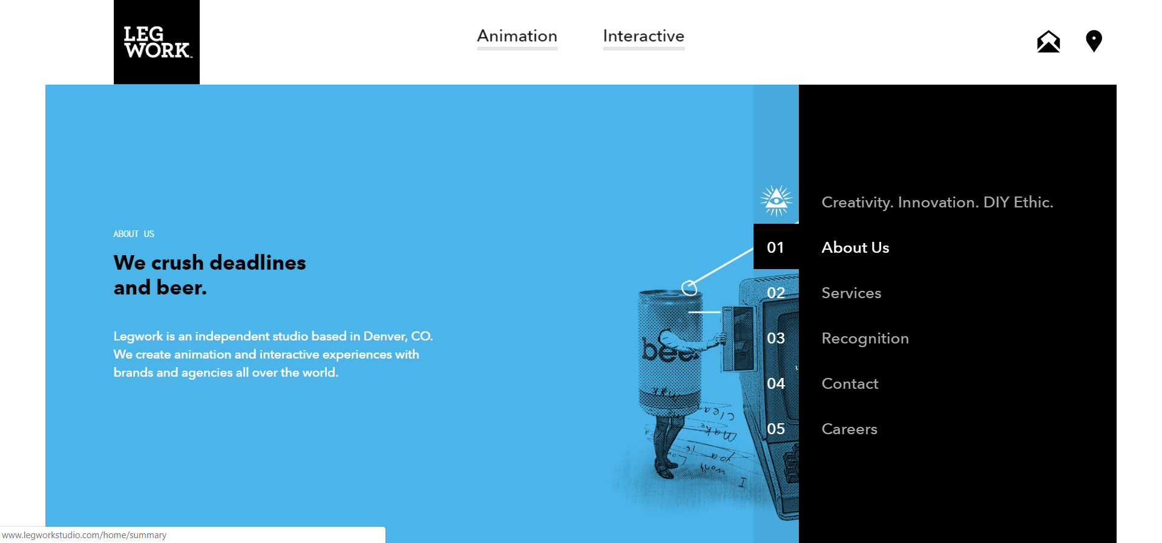

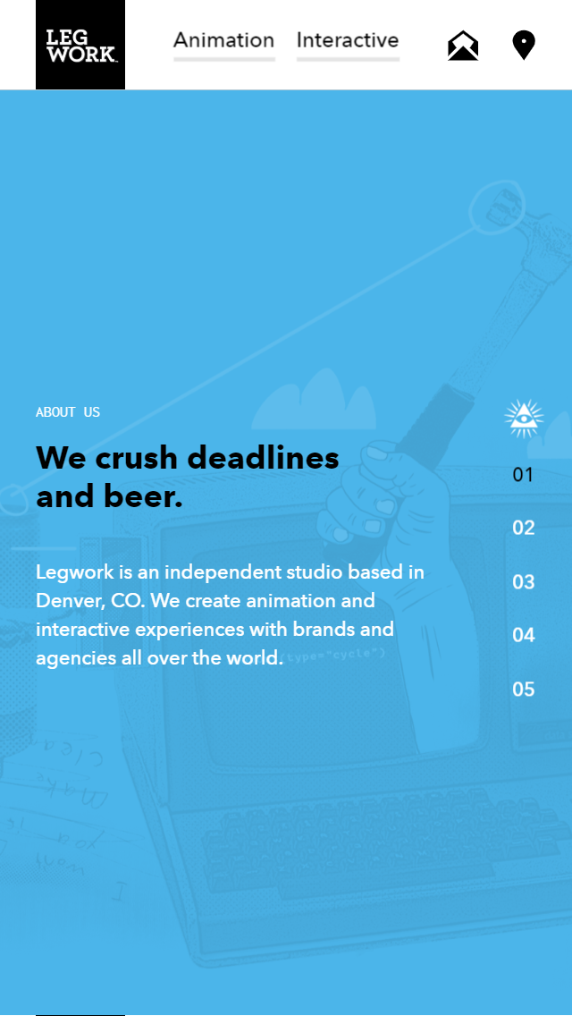
Development Process
Layout - Decided!
First Step - HTML
Second Step - CSS
Third Step - Iterate

Slide 6
Clear, semantic HTML
Efficient, well laid out CSS
Effective use of GitHub for version control.
Correctly selecting technical features
Building a fully developed design brief
Managing design consistency across the website
Technical Challenges
Essentially, I struggled to be decisive and commit to a design
Technically, this definitely stretched me beyond my ability!
Design Challenges

Slide 7
Ethical Issues
A ethical issue I was confronted with was the difficulty in balancing the project timeline and the core functionality of the product with key accessibility issues. In future projects I think it would be important to prioritize accessibility features more highly to ensure consumers are being treated fairly.

Slide 8

Favorite parts
Finishing the project...

Slide 9
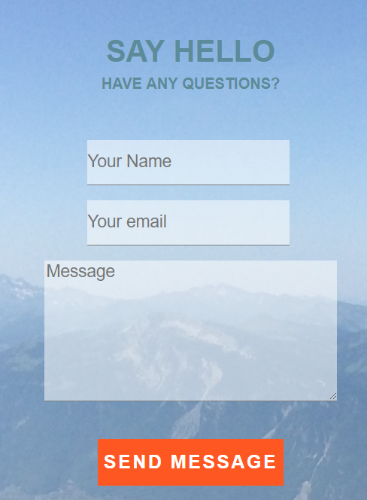
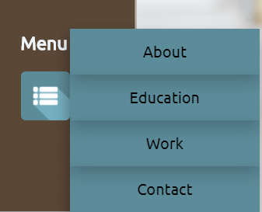
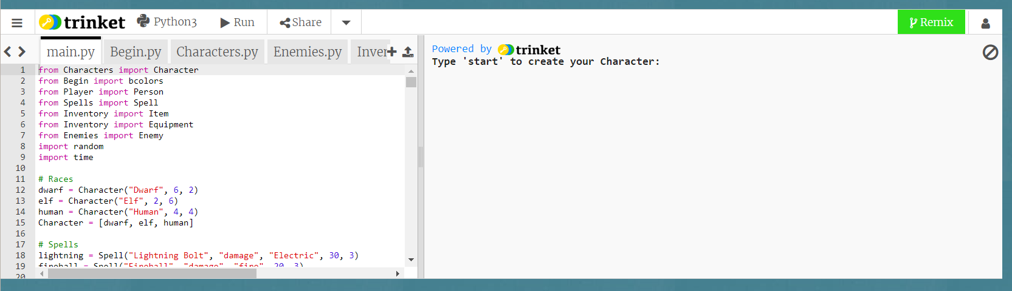
The Sprinkles...

Slide 10

Thanks For Listening

